Slide 1




Using External Secondary Data

Slide 2
Recap Last Class

Slide 3
Learning Objectives
Describe the process of searching for published external secondary data
List 3 common uses of the information supplied by standard marketing info services
Define geodemography
Describe the use of diary panels and scanner data for assessing product sales
Discuss the purpose and operation of people meters
Define single-source data

Slide 4
Marketing Research Process
In Chapter 7, we shift our focus onto retrieving existing info from external sources. Some of this external info may end up in the company’s DSS; some of it may also be in the form of “big data.”

Slide 5
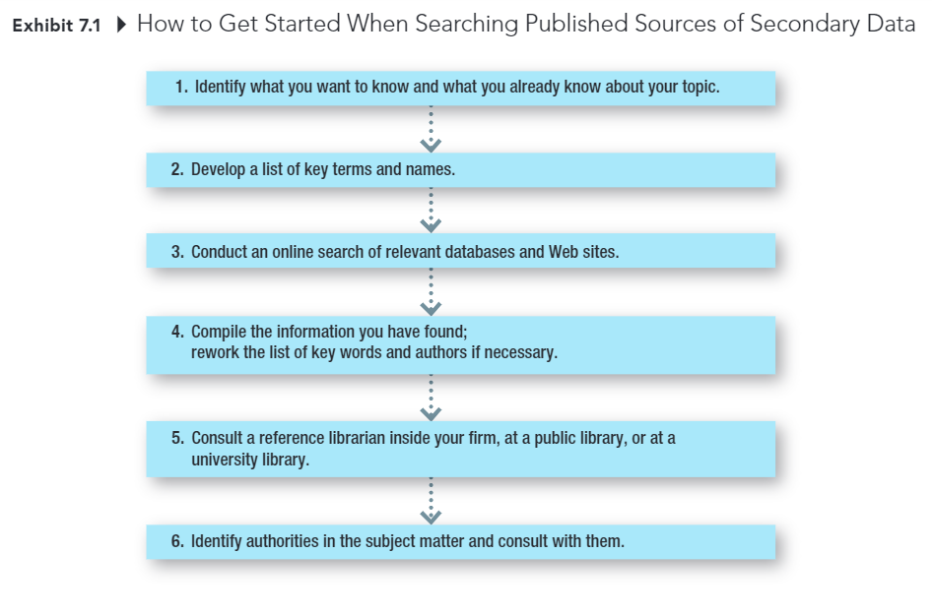
Marketing Research Process

Slide 6
Standardized Marketing Information
Secondary data collected by companies that sell the data to multiple companies, allowing the costs of collecting, editing, coding, and analyzing them to be shared.
Notes:
The data are standardized so that they can be used by multiple companies rather than customized for a specific company

Slide 7
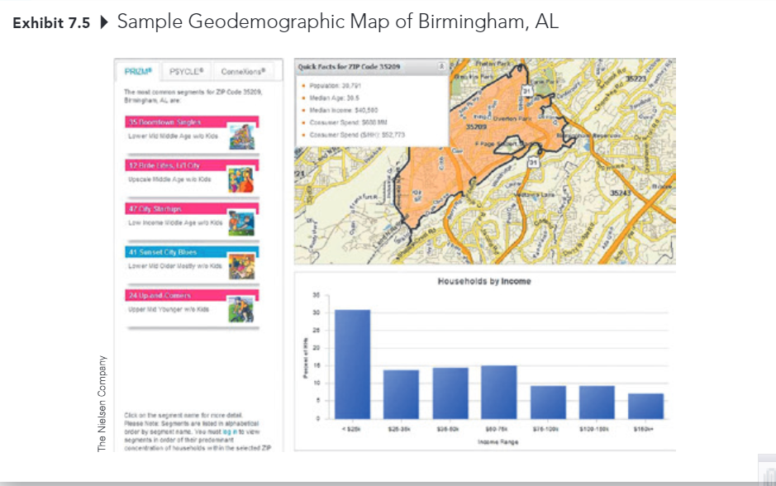
Profiling Customers
Geodemography: the availability of demographic, consumer behavior, and lifestyle data by arbitrary geographic boundaries that are typically quite small.

Slide 8
Measuring Product Sales Market Share
(Online) Diary Panels Scanners

Slide 9
Measuring Advertising Exposure and Effectiveness
Television and Radio
Nielson TV ratings
Arbitron radio ratings
Print Media
Starch Ad Readership (magazine)
Internet
Nielson Digital Voice
ComScore Mobile Metrix
Cross-platform Services
Simmons National Consumer Study
Gfk MRI
comScore, WebTrends, Nielsen

Slide 10
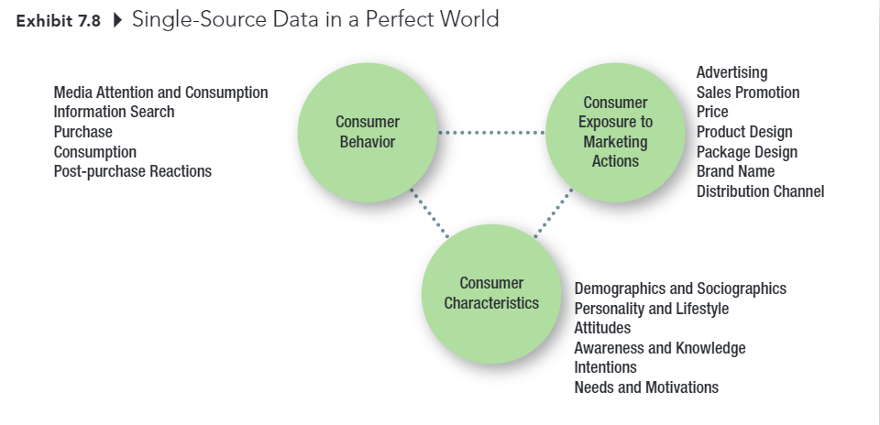
Single-Source Data in a Perfect World

Slide 11
Recap

Slide 12
5-min snippet

